Slide 1
Clustering with K-Mean
PREPARED BY BAHARIA

Slide 2
INTRO
In this chapter we will discuss an unsupervised learning task called clustering. Clustering is used to find groups of similar observations within a set of unlabeled data. We will discuss the K-Means clustering algorithm, apply it to an image compression problem, and learn to measure its performance. Finally, we will work through a semi-supervised learning problem that combines clustering with classification.
Clustering, or cluster analysis, is the task of grouping observations such that members of the same group, or cluster, are more similar to each other by a given metric than they are to the members of the other clusters. As we know that the goal of unsupervised learning is to discover hidden structure or patterns in unlabeled training data.
For example, assume that your training data consists of the samples plotted in the following figure

Slide 3
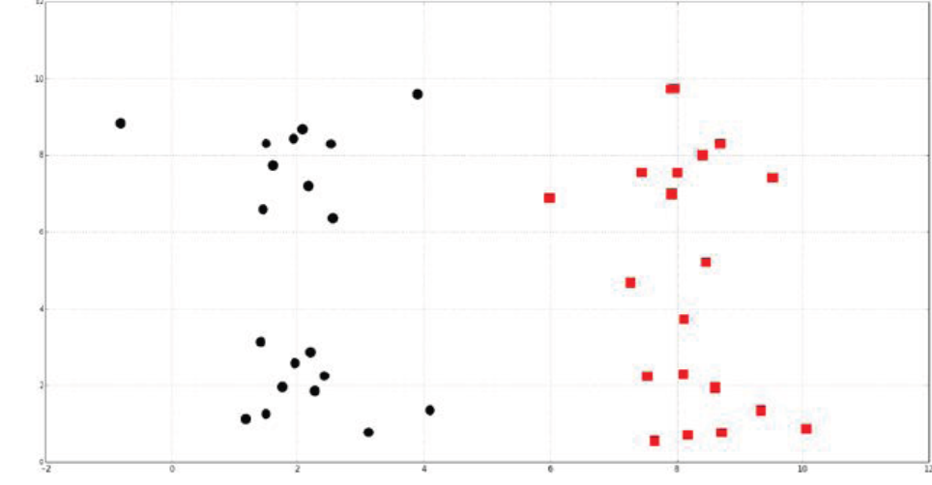
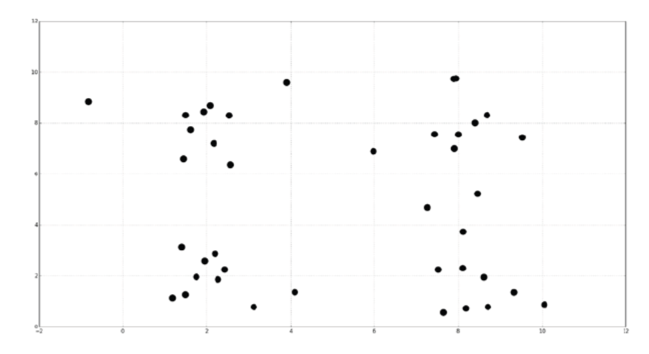
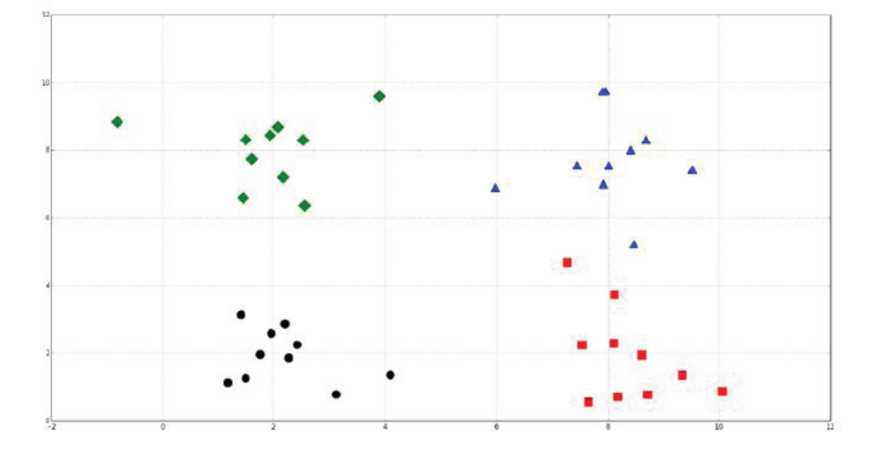
Cont.

Slide 4
Cont.
Clustering might reveal the following two groups, indicated by squares and circles
Clustering could also reveal the following four groups
Clustering is commonly used to explore a dataset.
  Social networks can be clustered to identify communities and to suggest missing connections between people.
  In biology, clustering is used to find groups of genes with similar expression patterns.
  Recommendation systems sometimes employ clustering to identify products or media that might appeal to a user.
  In marketing, clustering is used to find segments of similar consumers.

Slide 5
Clustering with the K-Means algorithm
K-Means is an iterative process of moving the centers of the clusters, or the centroids, to the mean position of their constituent points, and re-assigning instances to their closest clusters.
The K-Means algorithm is a clustering method that is popular because of its speed and scalability.
The titular K is a hyperparameter that specifies the number of clusters that should be created; K-Means automatically assigns observations to clusters but cannot determine the appropriate number of clusters. K must be a positive integer that is less than the number of instances in the training set. Sometimes, the number of clusters is specified by the clustering problem's context.
Other problems may not require a specific number of clusters, and the optimal number of clusters may be ambiguous
For example, a company that manufactures shoes might know that it is able to support manufacturing three new models. To understand what groups of customers to target with each model, it surveys customers and creates three clusters from the results. That is, the value of K was specified by the problem's context

Slide 6
Logical of finding k-means
assume There are two explanatory variables and each instance has two features. The instances are plotted in the following figure:

Slide 7
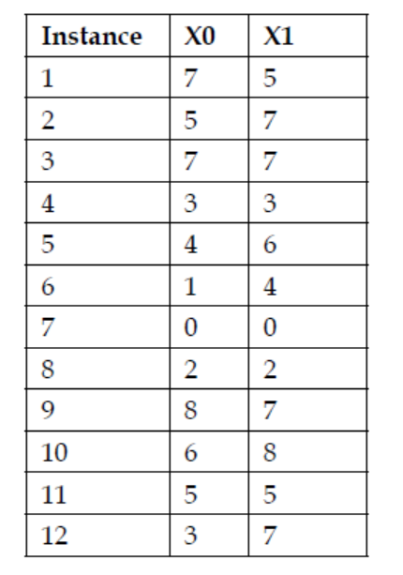
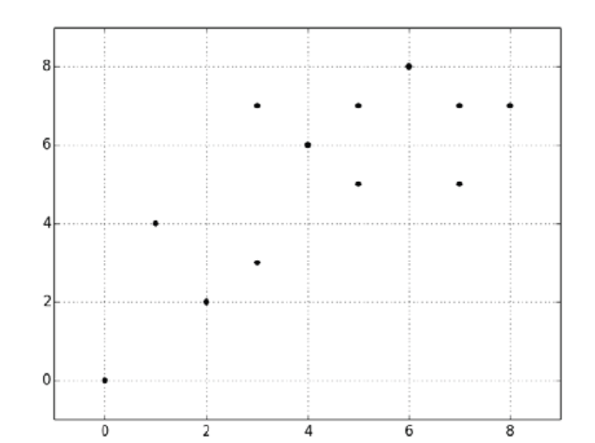
Cont.

Slide 8
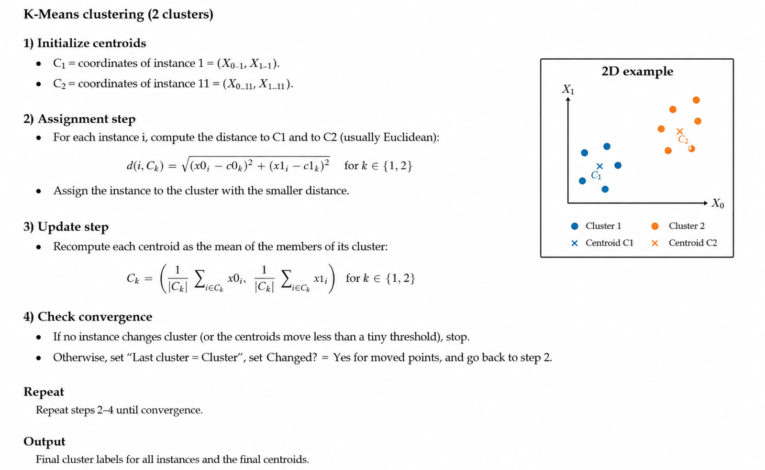
Cont.

Slide 9
cont.
Assume that K-Means initializes the centroid for the first cluster to the fifth instance and the centroid for the second cluster to the eleventh instance. For each instance, we will calculate its distance to both centroids, and assign it to the cluster with the closest centroid. The initial assignments are shown in the Cluster column of the following table:
The plotted centroids and the initial cluster assignments are shown in the following graph. Instances assigned to the first cluster are marked with Xs, and instances assigned to the second cluster are marked with dots. The markers for the centroids are larger than the markers for the instances.
Now we will move both centroids to the means of their constituent instances, recalculate the distances of the training instances to the centroids, and reassign the instances to the closest centroids:

Slide 10
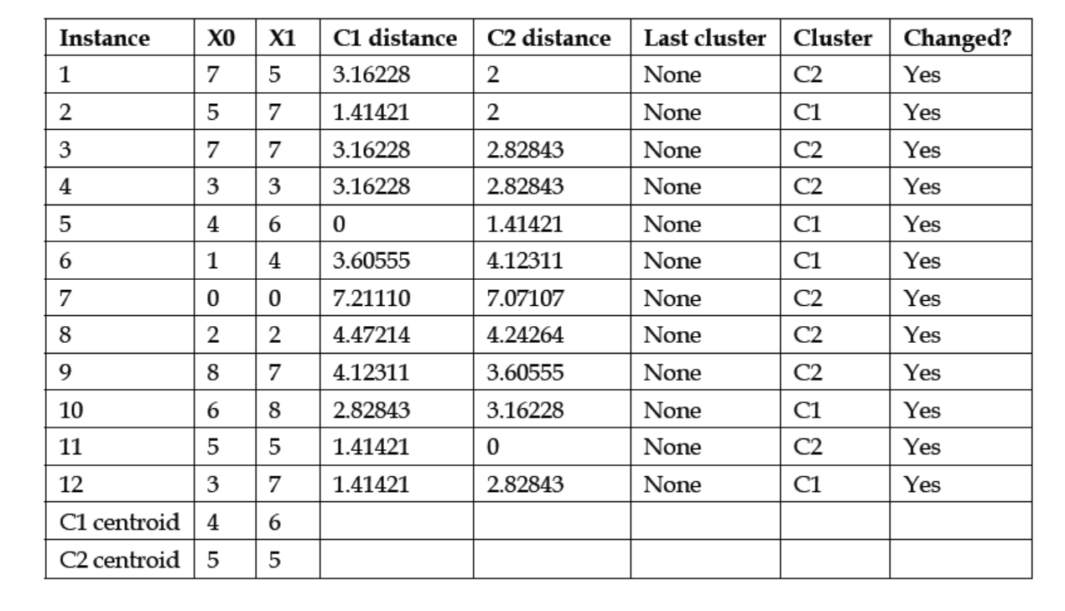
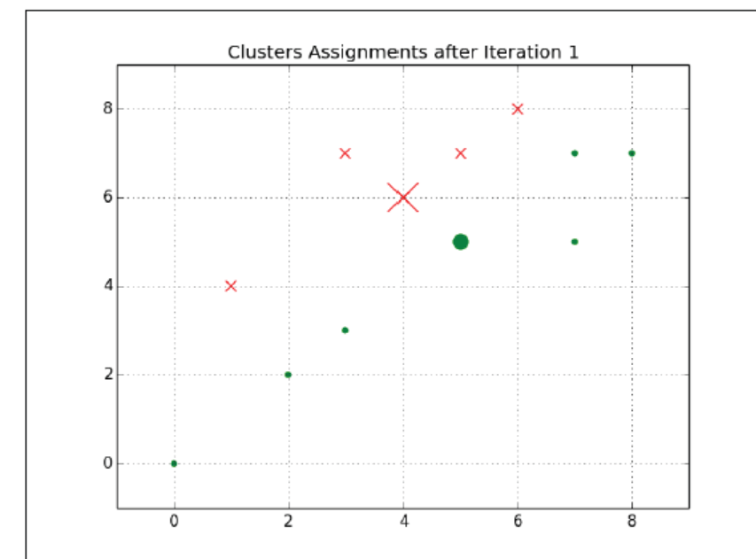
Cont.

Slide 11
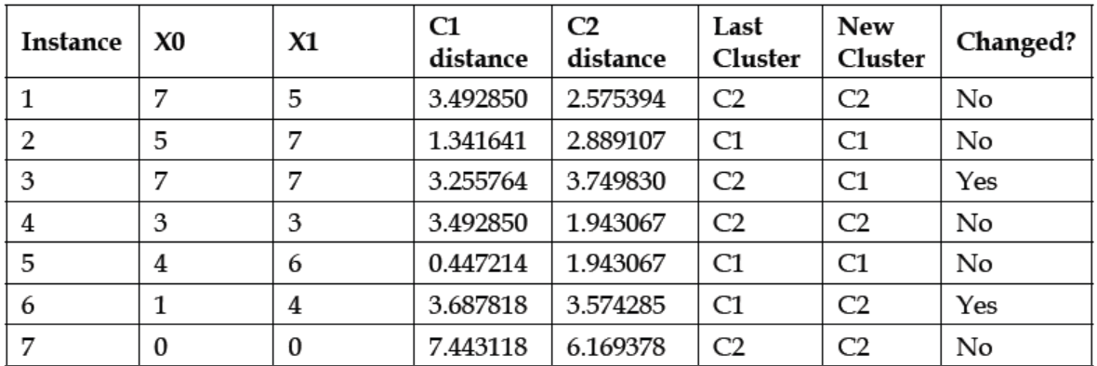
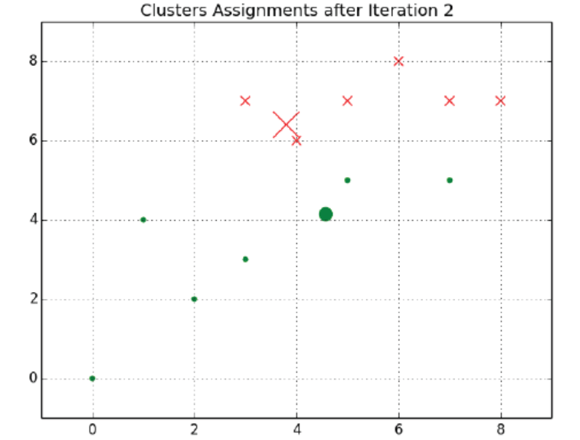
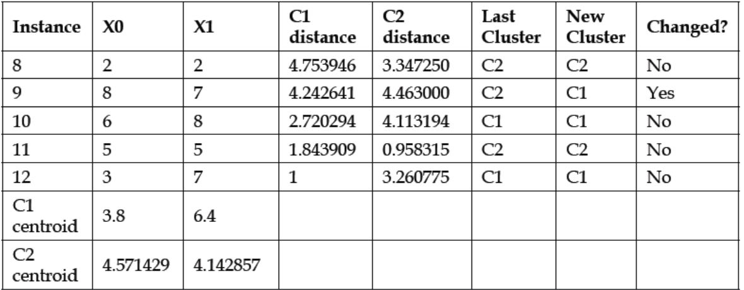
Cont.

Slide 12
Cont.
None of the instances' centroid assignments will change in the next iteration; K-Means will continue iterating until some stopping criteria is satisfied. Usually, this criterion is either a threshold for the difference between the values of the cost function for subsequent iterations, or a threshold for the change in the positions of the centroids between subsequent iterations. If these stopping criteria are small enough, K-Means will converge on an optimum. This optimum will not necessarily be the global optimum.

Slide 13
Local optima
A local optimum (local minimum) is a solution that has a lower value of the objective (cost) function than
all other nearby solutions, but is not necessarily the lowest possible value over the entire
solution space (the global optimum).

Slide 14
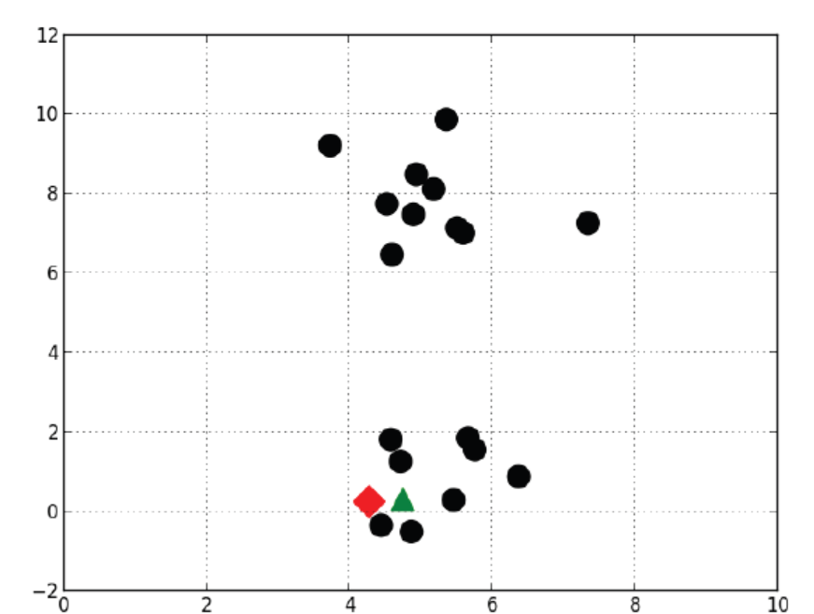
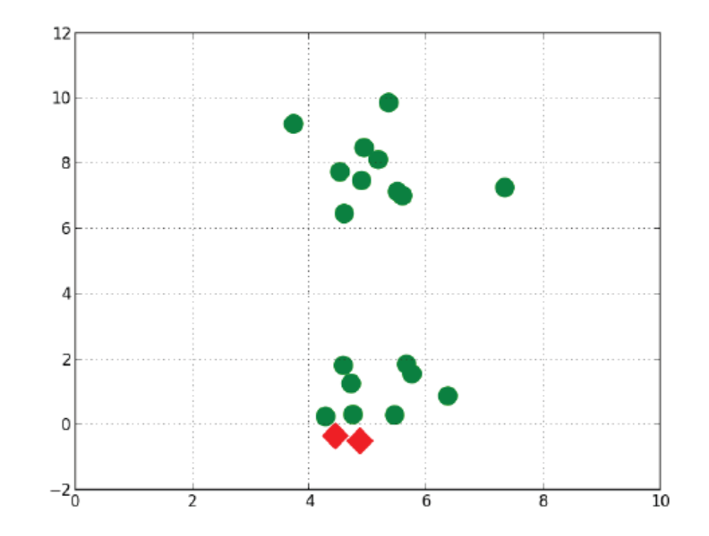
cont.
Recall that K-Means initially sets the positions of the clusters' centroids to the positions of randomly selected observations. Sometimes, the random initialization is unlucky and the centroids are set to positions that cause K-Means to converge to a local optimum. For example, assume that K-Means randomly initializes two cluster centroids to the following positions:

Slide 15
Cont.
K-Means will eventually converge on a local optimum like that shown in the following figure. These clusters may be informative, but it is more likely that the top and bottom groups of observations are more informative clusters. To avoid local optima, K-Means is often repeated dozens or even hundreds of times. In each iteration, it is randomly initialized to different starting cluster positions. The initialization that minimizes the cost function best is selected.

Slide 16
Elbow method
If K is not specified by the problem's context, the optimal number of clusters can be estimated using a technique called the elbow method.
The elbow method plots the value of the cost function produced by different values of K. As K increases, the average distortion will decrease; each cluster will have fewer constituent instances, and the instances will be closer to their respective centroids.
However, the improvements to the average distortion will decline as K increases.
The value of K at which the improvement to the distortion declines the most is called the elbow.

Slide 17
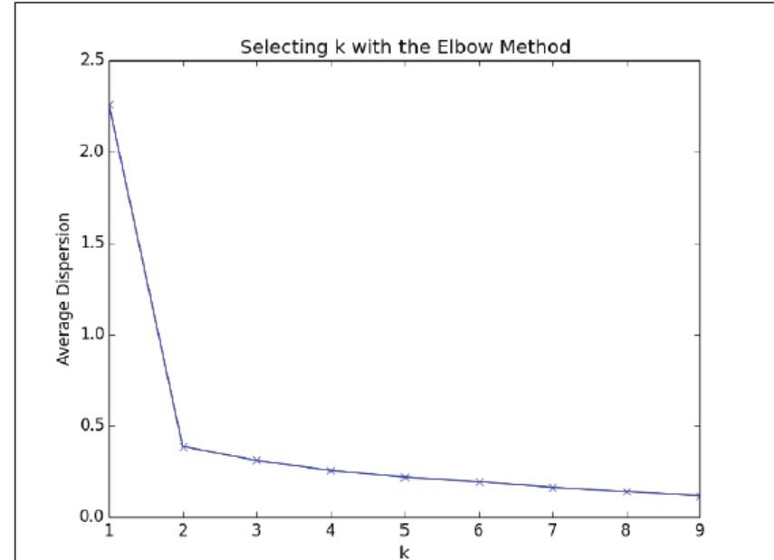
Cont.
Let's use the elbow method to choose the number of clusters for a dataset. The following scatter plot visualizes a dataset with two obvious clusters
The average distortion improves rapidly as we increase K from 1 to 2. There is little improvement for values of K greater than 2. Now let's use the elbow method on the following dataset with three clusters:

Slide 18
Evaluating clusters(silhouette coefficient)
The silhouette coefficient is a measure of the compactness and separation of the clusters. It increases as the quality of the clusters increase; it is large for compact clusters that are far from each other and small for large, overlapping clusters. The silhouette coefficient is calculated per instance; for a set of instances, it is calculated as the mean of the individual samples' scores.

Slide 19
Image quantization
In the previous sections, we used clustering to explore the structure of a dataset.
Now let's apply it to a different problem. Image quantization is a lossy compression method that replaces a range of similar colors in an image with a single color.
Quantization reduces the size of the image file since fewer bits are required to
represent the colors.
In the following example, we will use clustering to discover a compressed palette for an image that contains its most important colors. We will then rebuild the image using the compressed palette.

Slide 20
Clustering to learn features
In this example, we will combine clustering with classification in a semi-supervised learning problem. You will learn features by clustering unlabeled data and use the learned features to build a supervised classifier.

